Slide 1
Introduction to deep learning with PyTorch I N T R O D U C T I O N T O D E E P L E A R N I N G W I T H P Y T O R C H
By Hina Ali(Exercises collected from multiple sources)

Slide 2
ML vs DL
Machine learning: relies on hand-crafted feature engineering
Deep learning: enables feature learning from raw data
DEEP LEARNING
Subset of ML
Inspired by connections in the human brain
Models require large amount of data

Slide 3
PyTorch: a deep learning framework
PyTorch is :
One of the most popular deep learning frameworks
The framework used in many published deep learning papers intuitive and user-friendly
Has much in common with NumPy
Importing PyTorch and related packages
PyTorch import in Python
import torch
PyTorch supports
image data with torchvision audio data with torchaudio text data with torchtext

Slide 4
Tensors: the building blocks of networks in PyTorch
Load from list
Load from NumPy array
torch
lst = [[1, 2, 3], [4, 5, 6]]
tensor = torch.tensor(lst)
np_array = np.array(array)
np_tensor = torch.from_numpy(np_array)
Like NumPy arrays, tensors are multidimensional representations of their elements

Slide 5
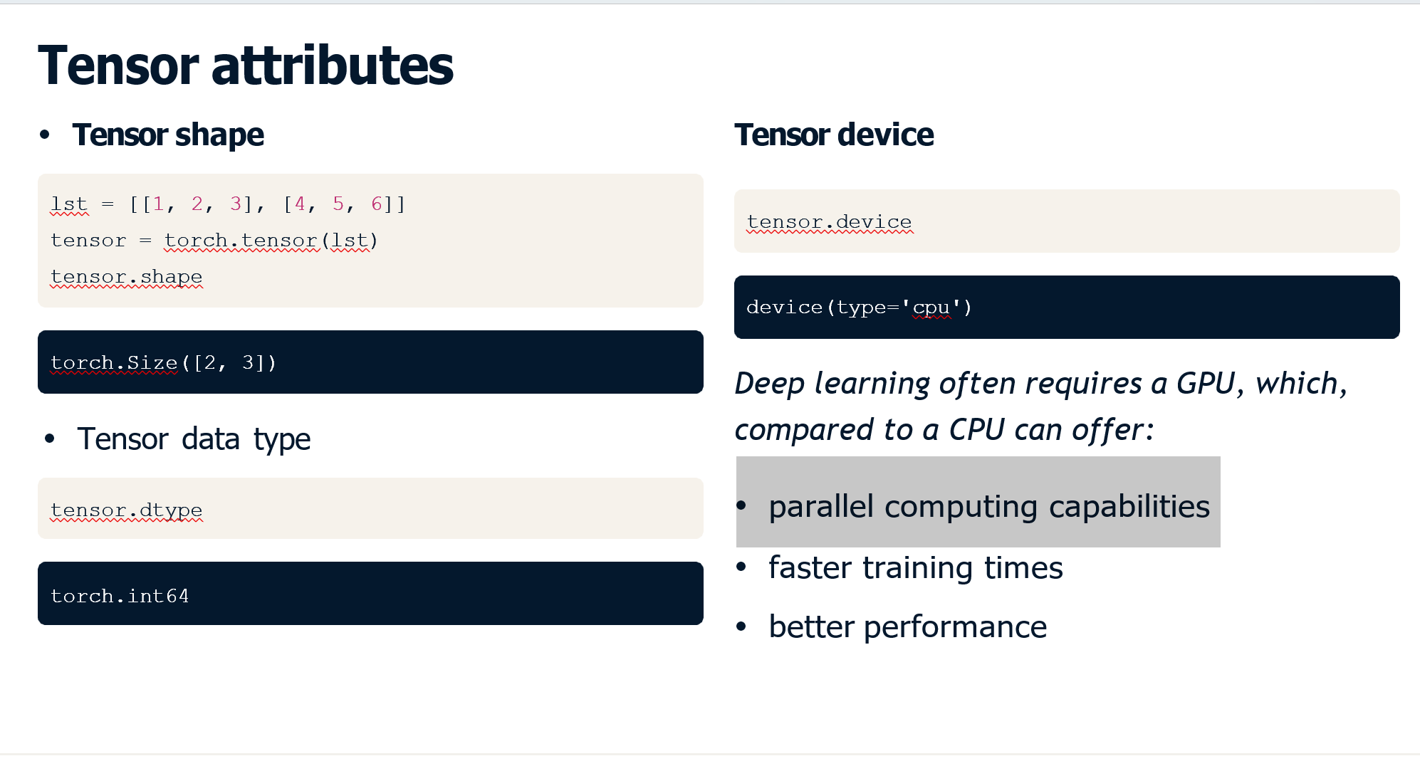
Two Content Layout with Table
First bullet point here
Second bullet point here
Third bullet point here
Class | Group A | Group B
Class 1 | 82 | 95
Class 2 | 76 | 88
Class 3 | 84 | 90

Slide 6
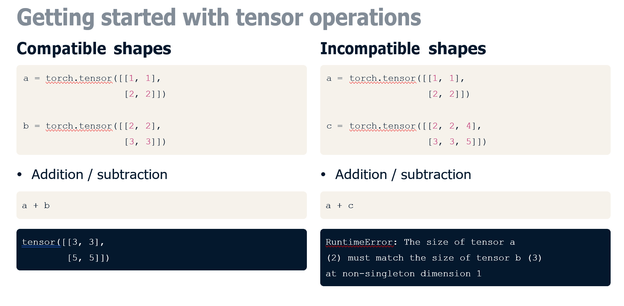
Two Content Layout with SmartArt
First bullet point here
Second bullet point here
Third bullet point here
Group A
Task 1
Task 2
Group B
Task 1
Task 2
Task 3
Task 4
Task 3

Slide 7
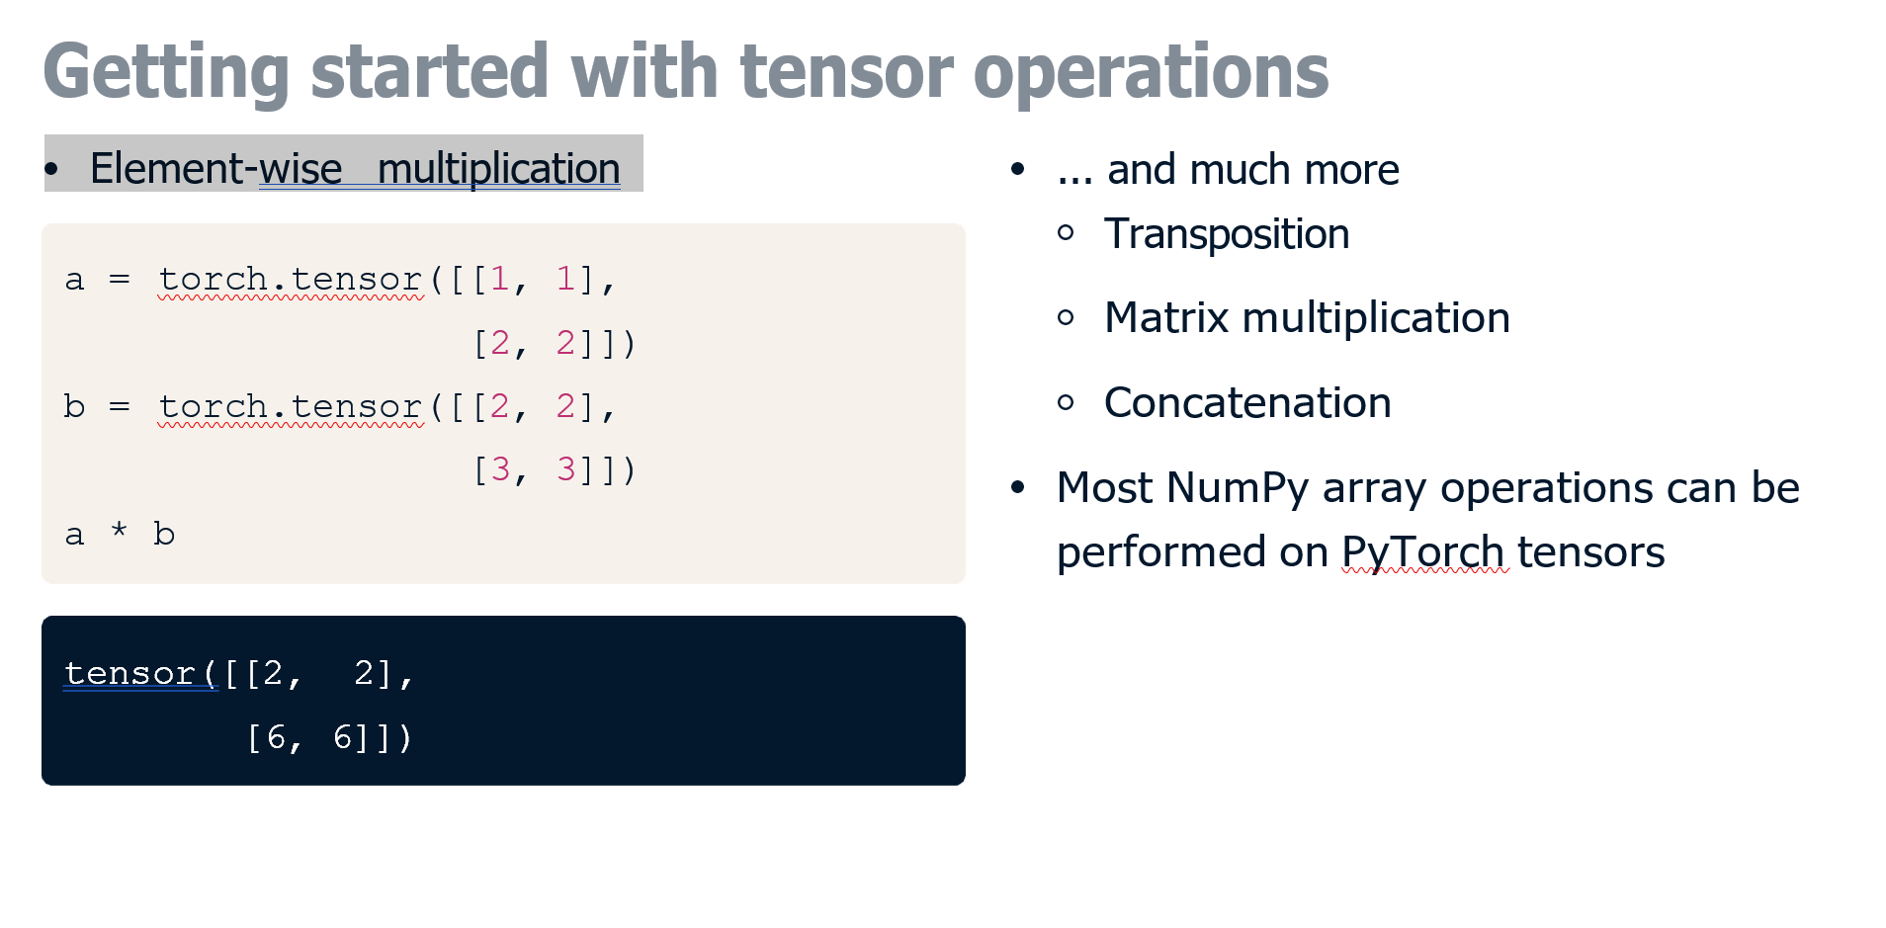
Add a Slide Title - 1

Slide 8

Add a Slide Title - 2

Slide 9
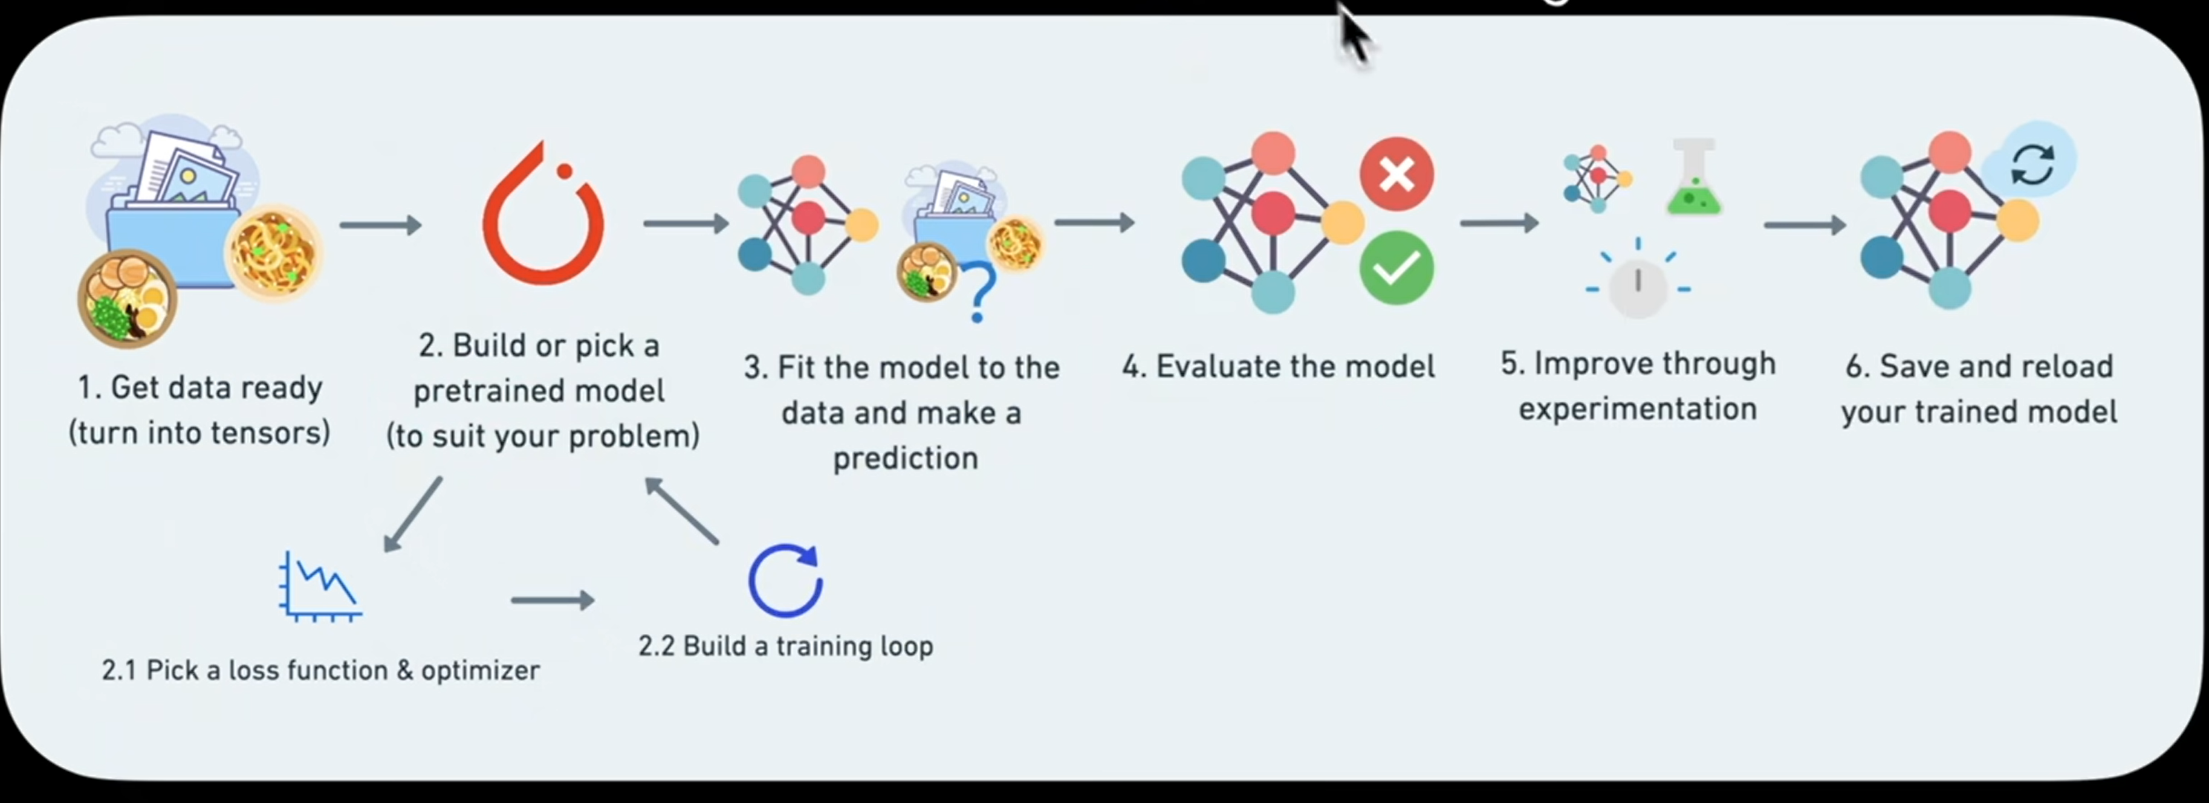
One of the Workflows(End to End)
Add your first bullet point here
Add your second bullet point here
Add your third bullet point here

Slide 10
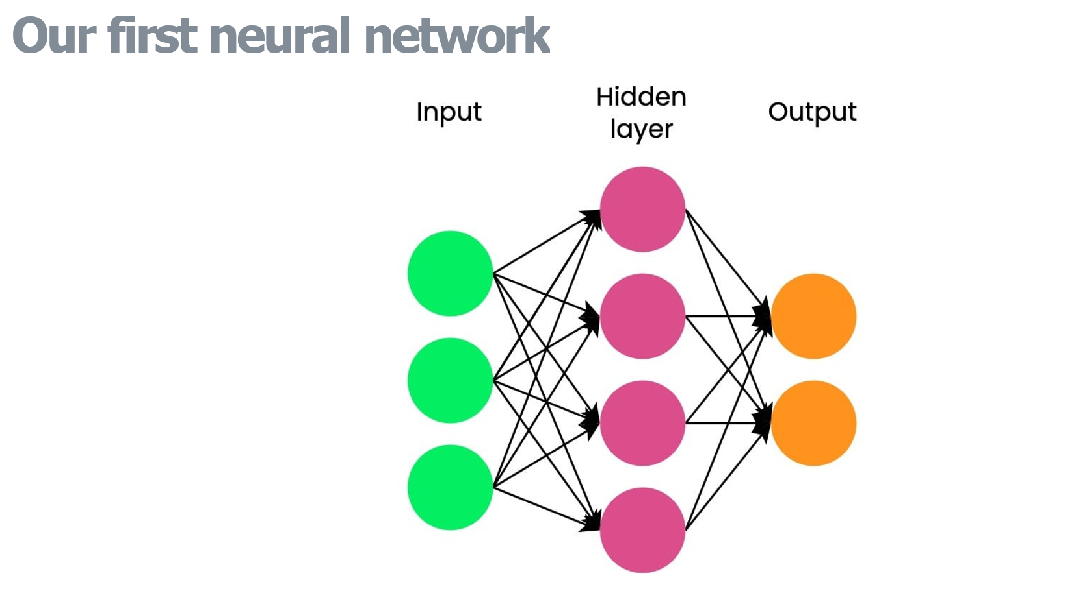
Add a Slide Title - 3

Slide 11
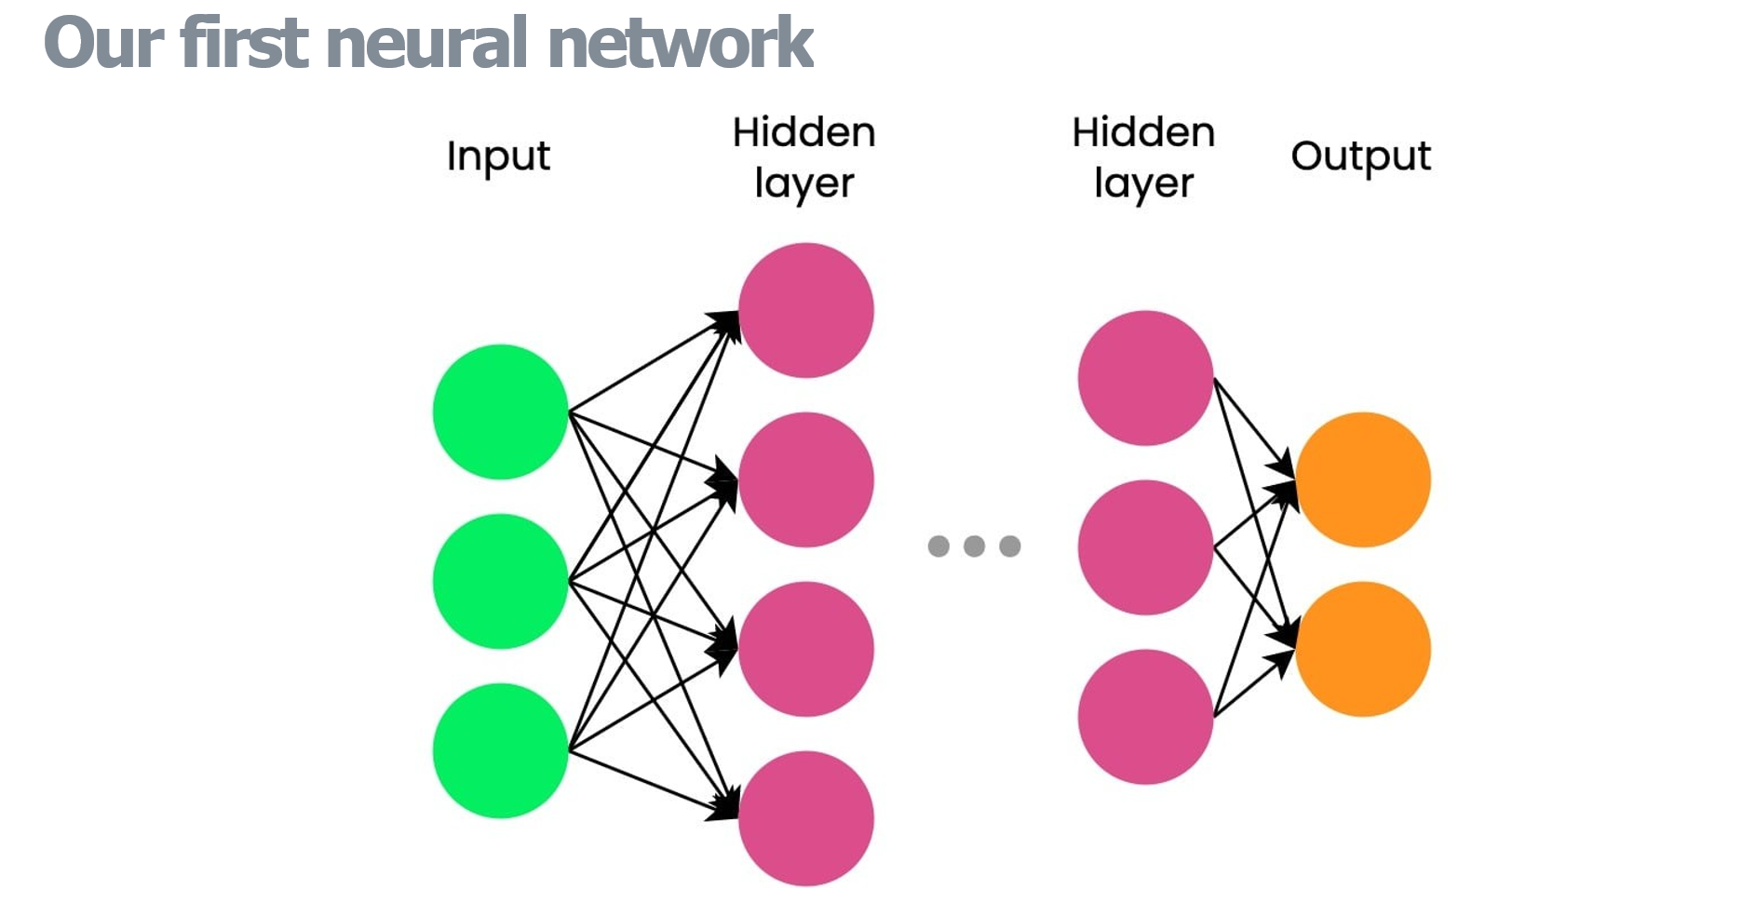

Slide 12
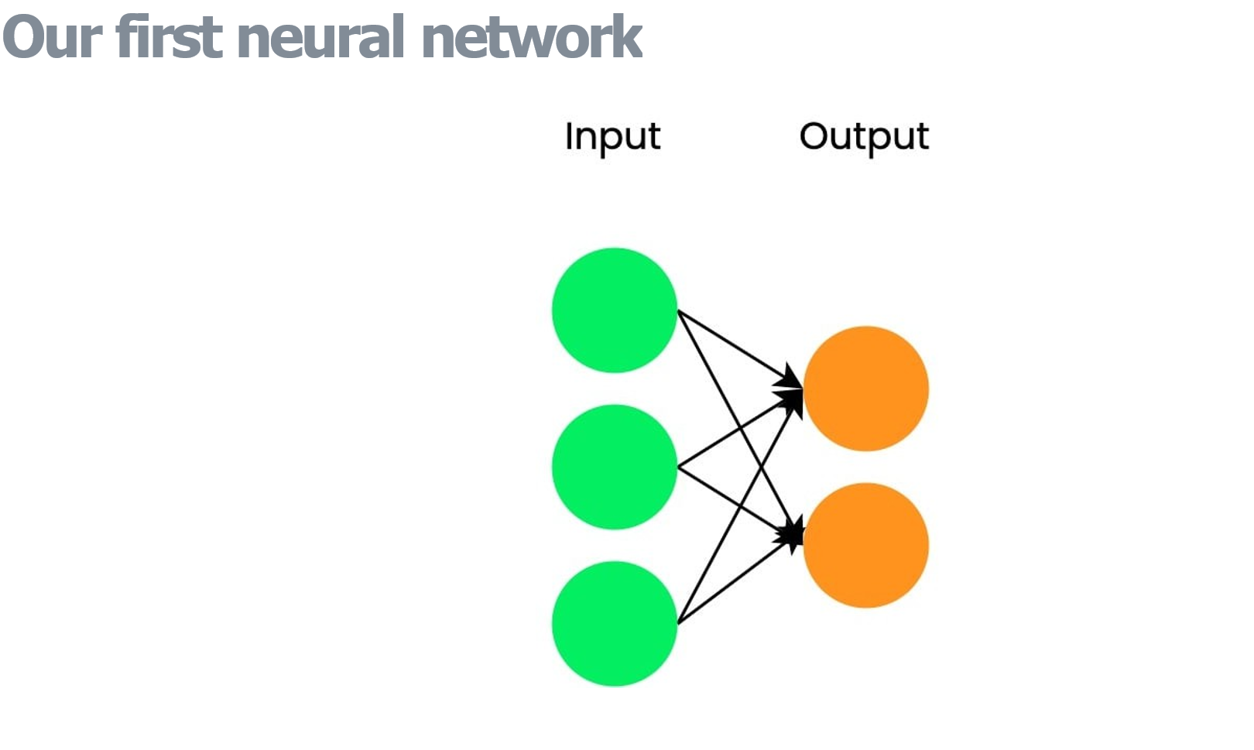
Add a Slide Title - 4

Slide 13
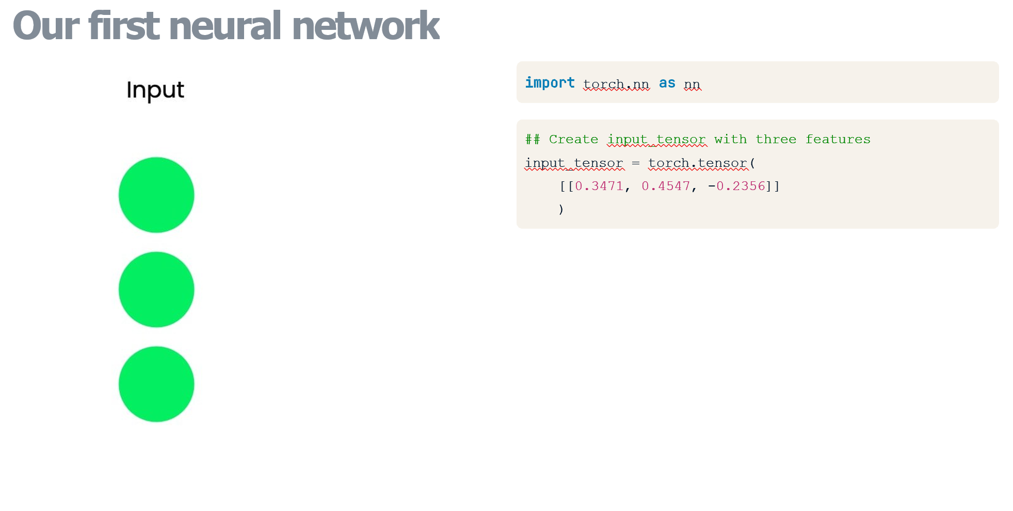
Add a Slide Title - 5

Slide 14
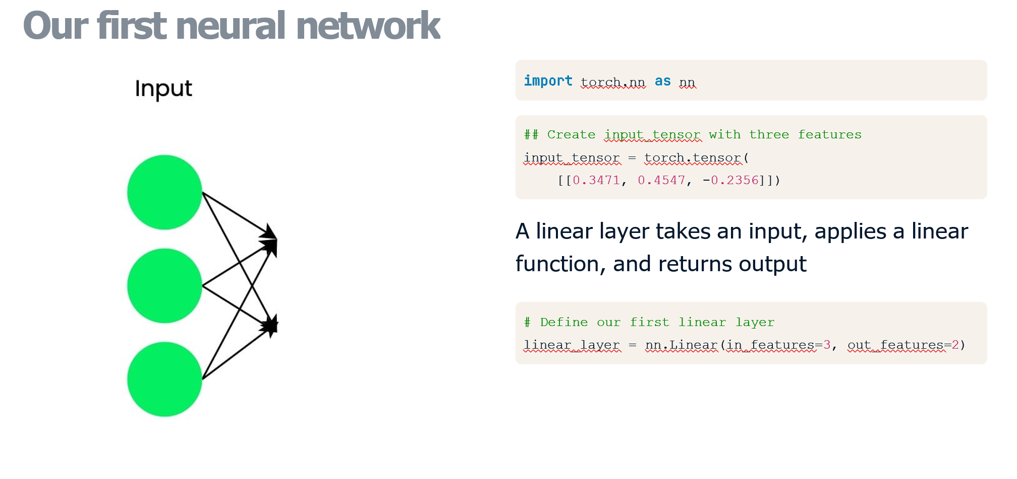

Slide 15
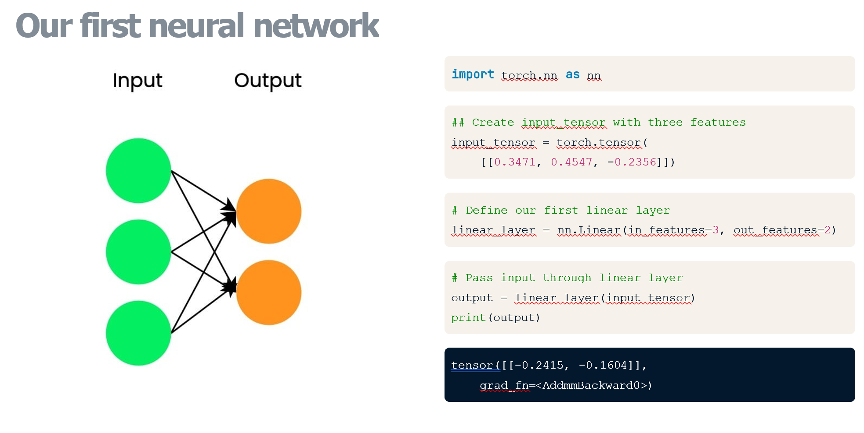

Slide 16
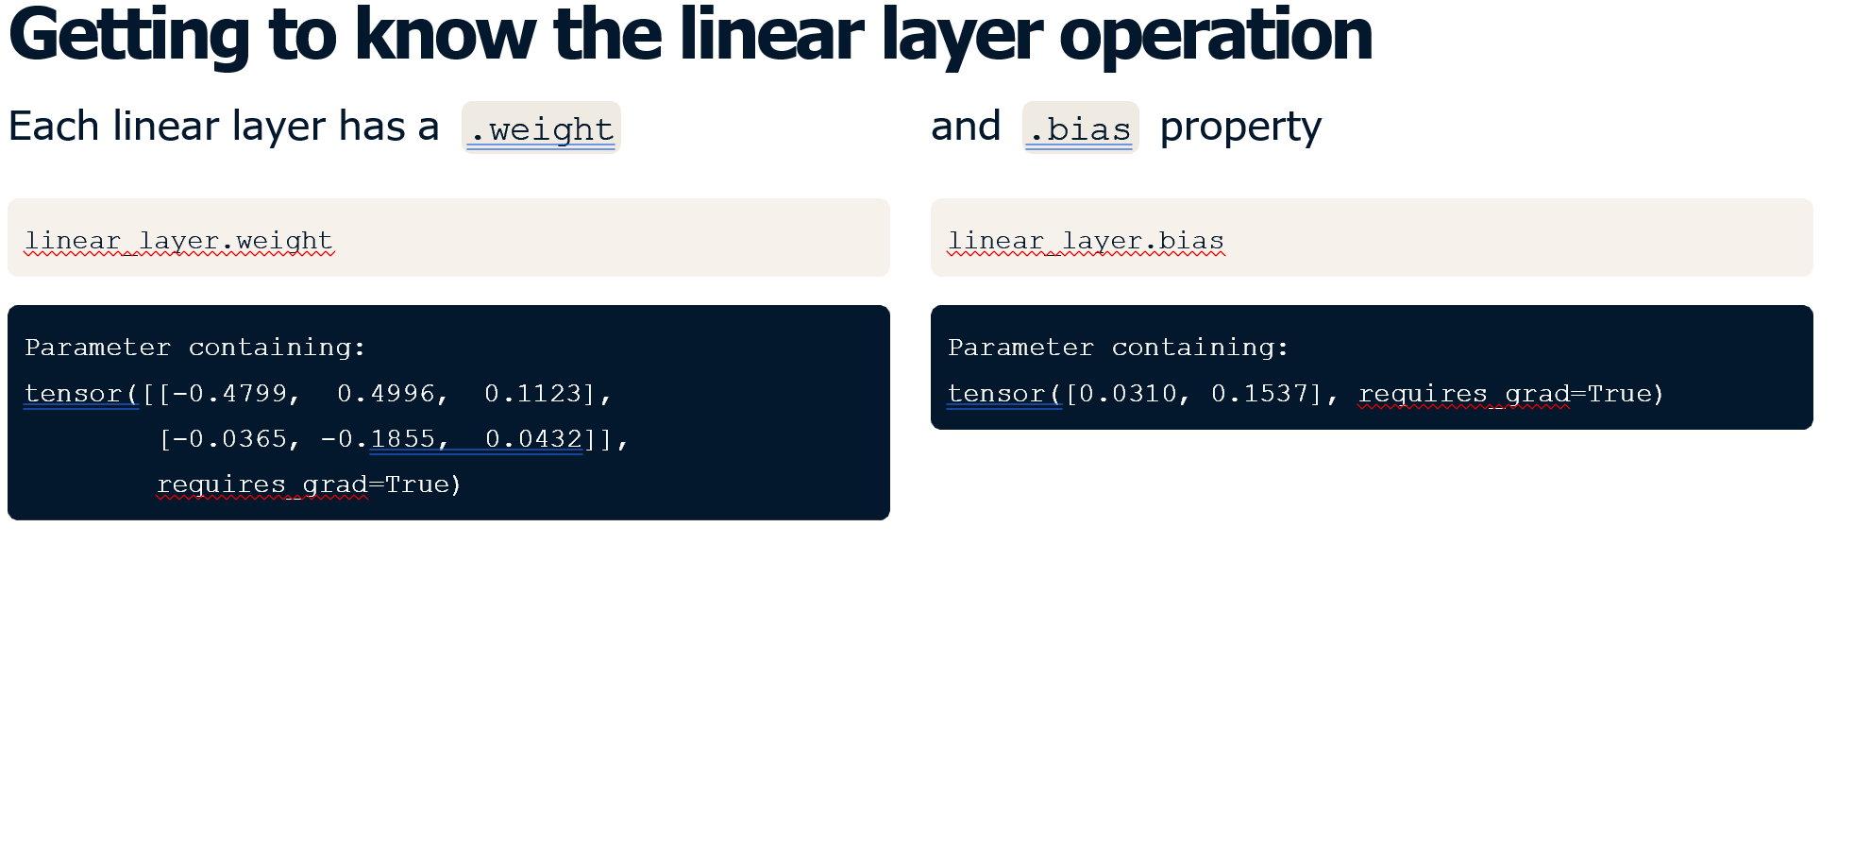

Slide 17
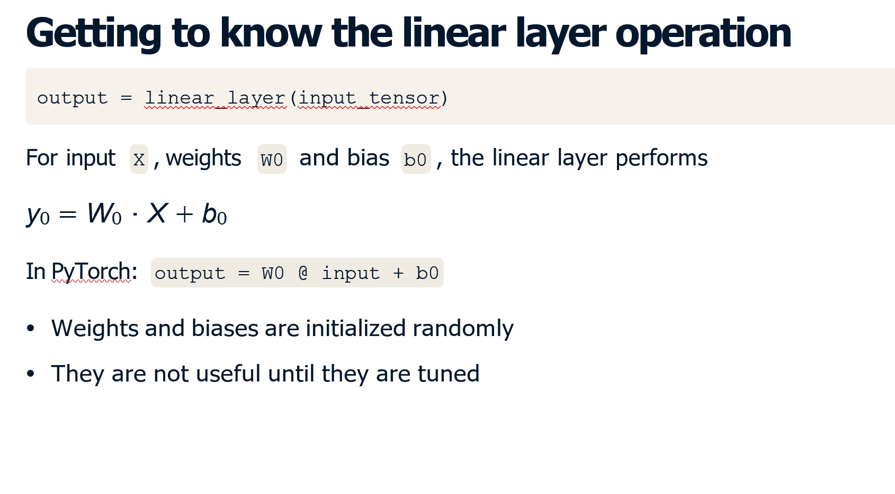

Slide 18
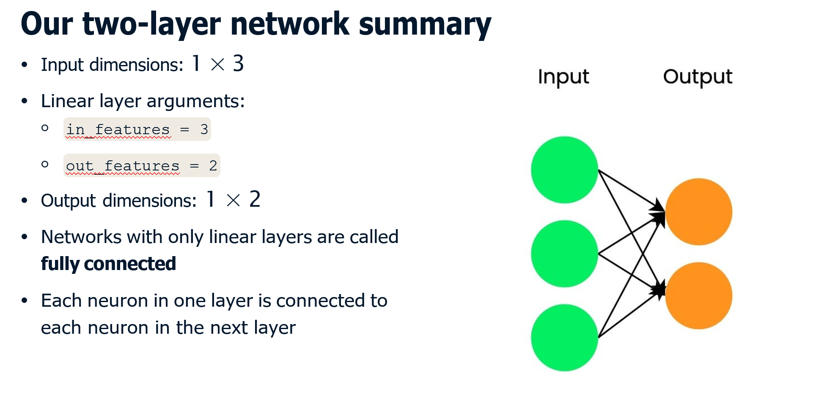

Slide 19
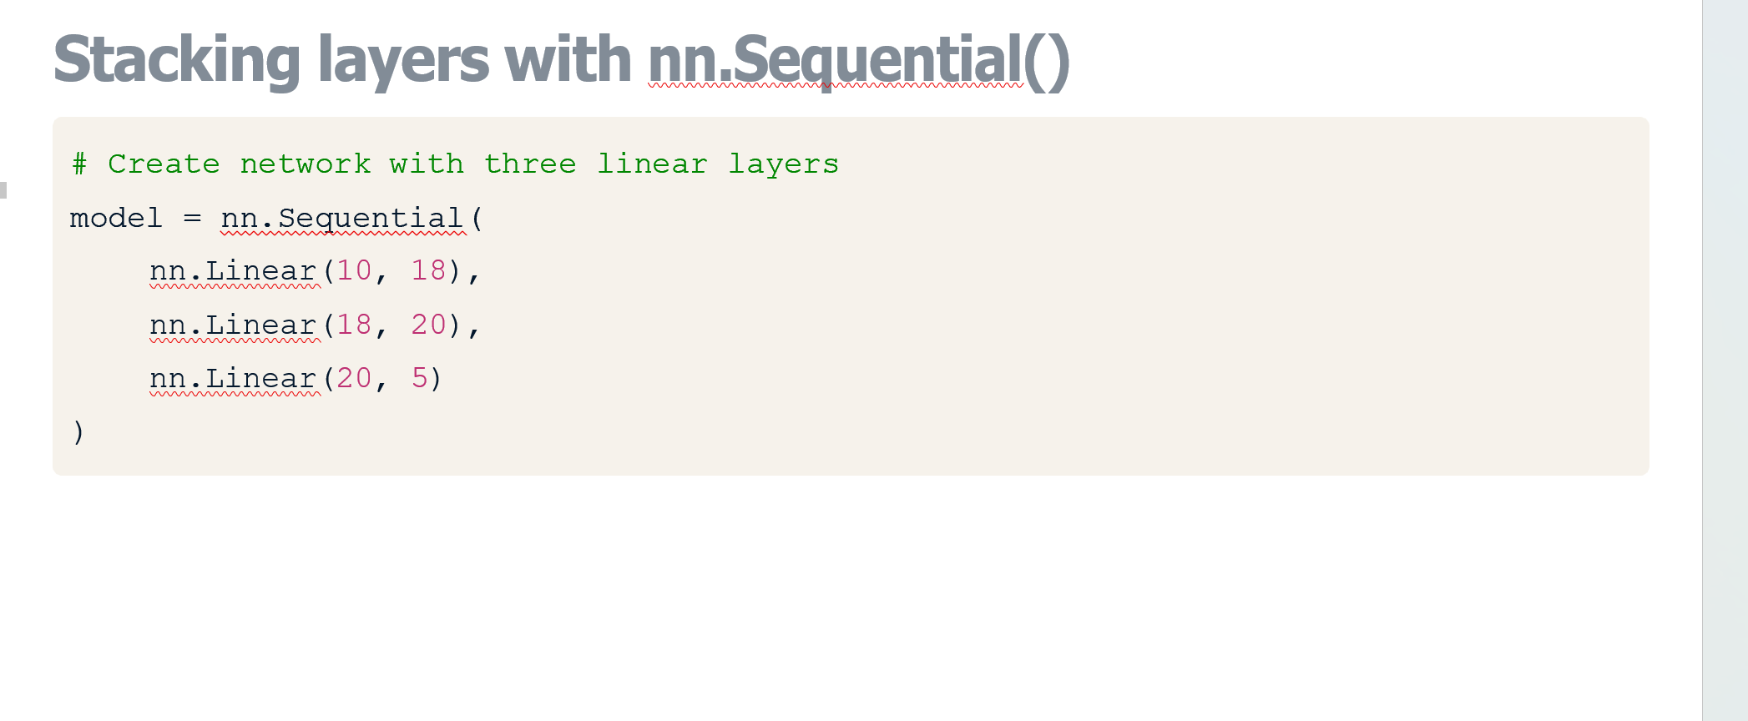

Slide 20
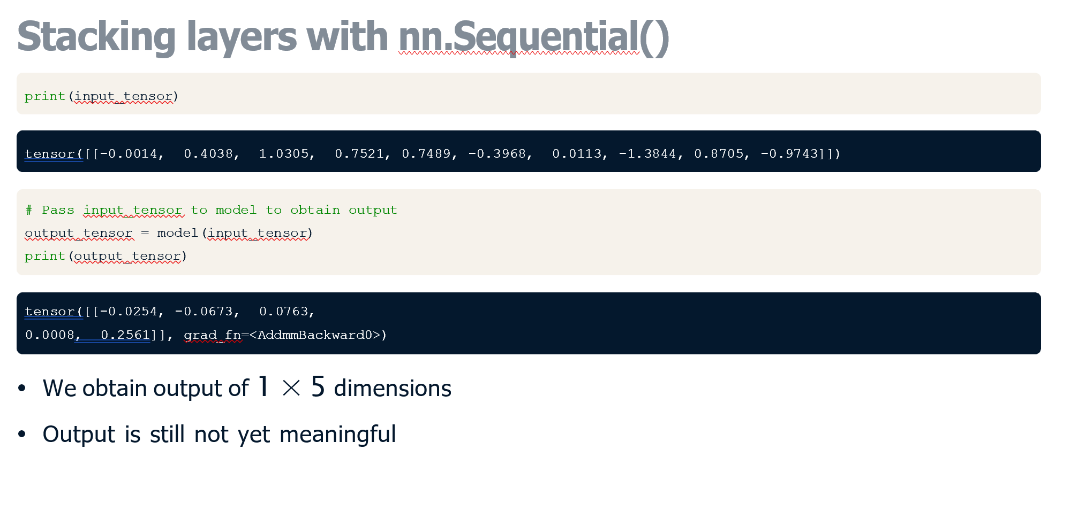

Slide 21
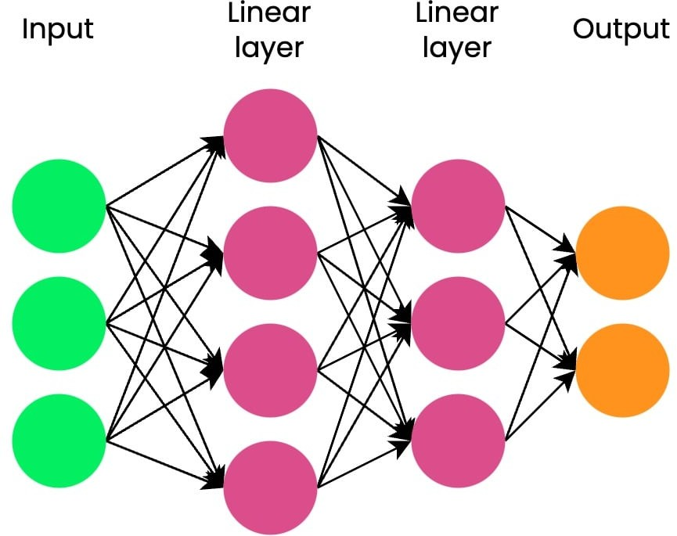
Discovering activation functions I N T R O D U C T I O N TO D E E P L E A R N I N G W I T H P Y TO R C H
Stacked linear operations
We have only seen linear layer networks
Each linear layer multiplies its respective input with layer weights and adds biases
Even with multiple stacked linear layers, output still has linear relationship with input

Slide 22
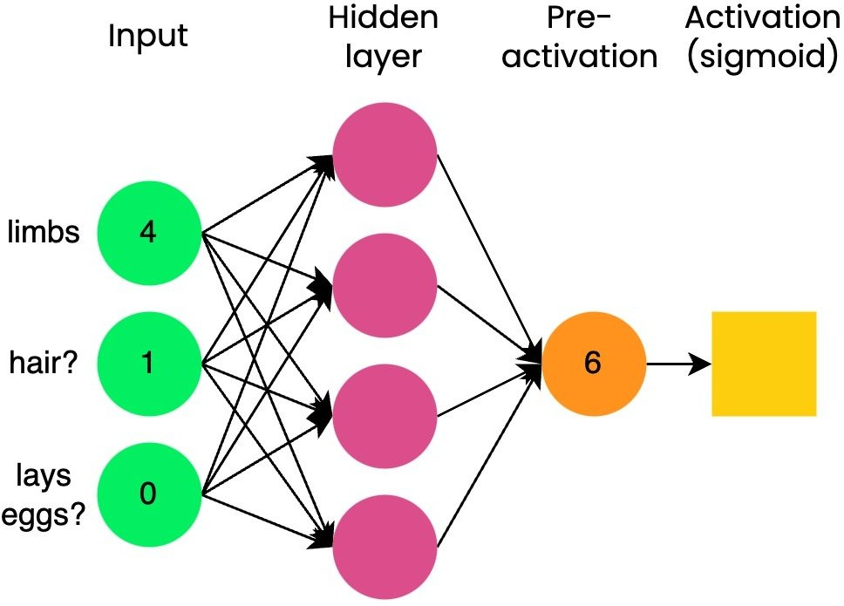
Why do we need activation functions?
Activation functions add non-linearity to the network
A model can learn more complex relationships with non-linearity
SIGMOID Activation Function( first introduced with the algorithm of Logistic regression aka logistic function)
Binary Classification
To predict whether animal is 1 (mammal) or 0 (not mammal),
we take the pre-activation (6), pass it to the sigmoid

Slide 23
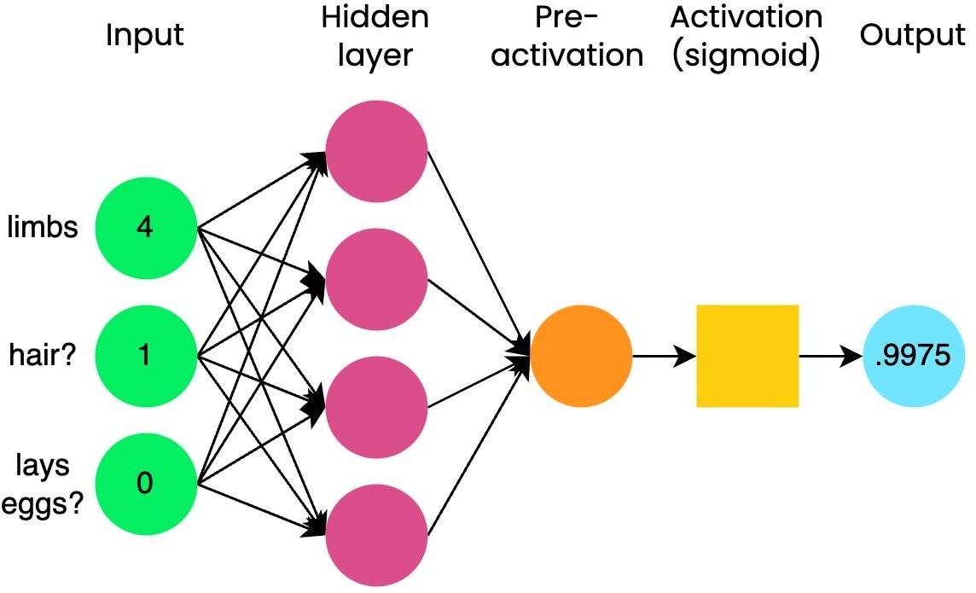
Binary Classification
Obtain a value between 0 and 1. shows probability of x belonging to a particular class.
Using the common threshold of 0.5:
If output is > 0.5, class label = 1 (mammal)
If output is <= 0.5, class label = 0 (not mammal)

Slide 24
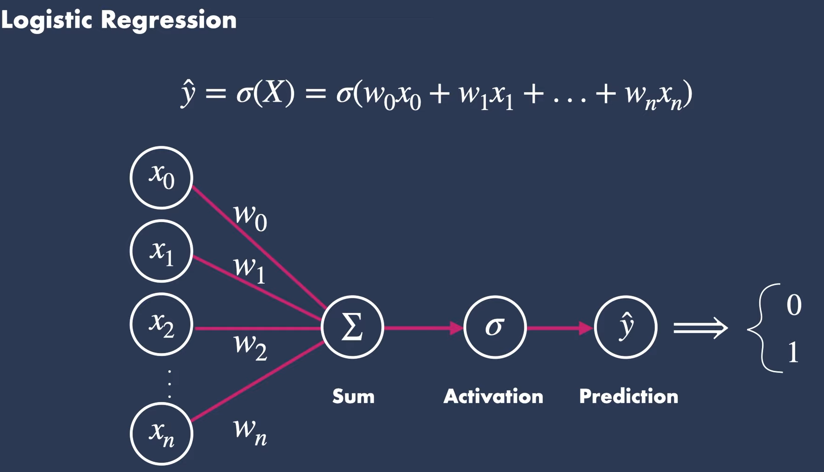
x0
x1
x2
Σ
σ
Prediction
xn

Slide 25
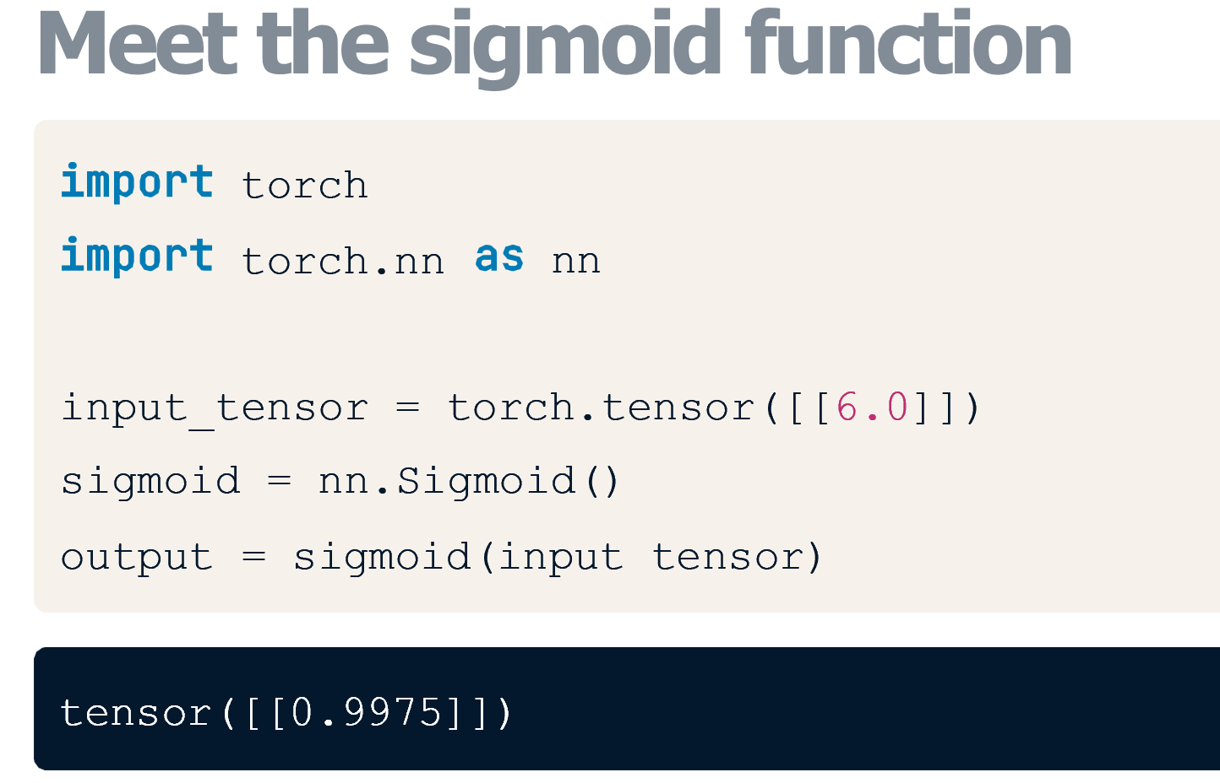

Slide 26
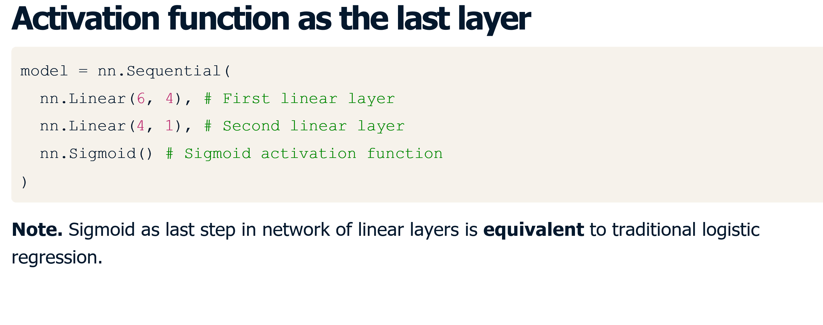

Slide 27
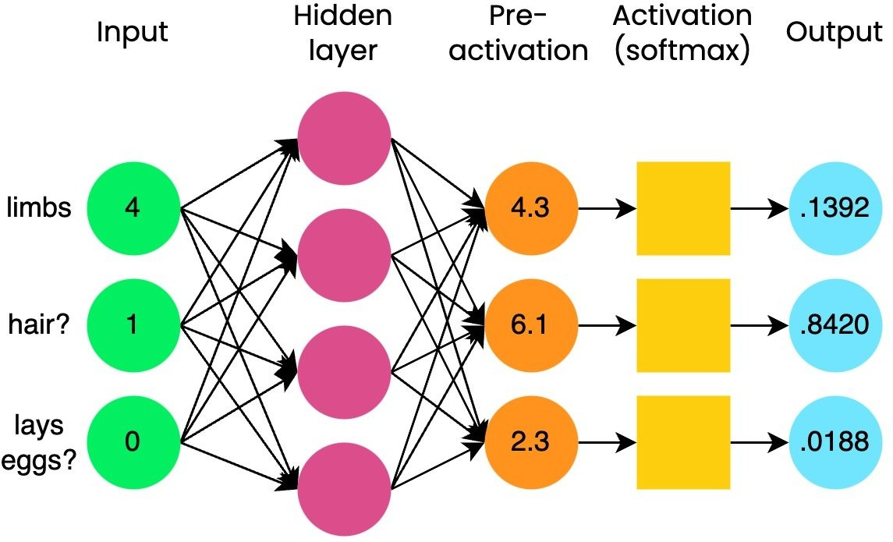
Softmax
used for multi-class classification problems
takes N-element vector as input and outputs vector of same size
say N=3 classes:
bird (0), mammal (1), reptile (2)
output has three elements, so softmax has three elements
outputs a probability distribution:
each element is a probability (it's bounded between 0 and 1)
the sum of the output vector is equal to 1

Slide 28
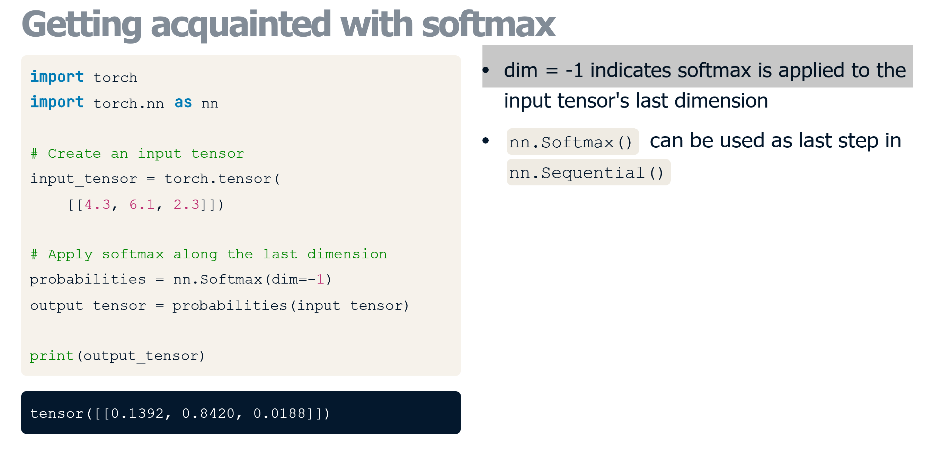

Slide 29
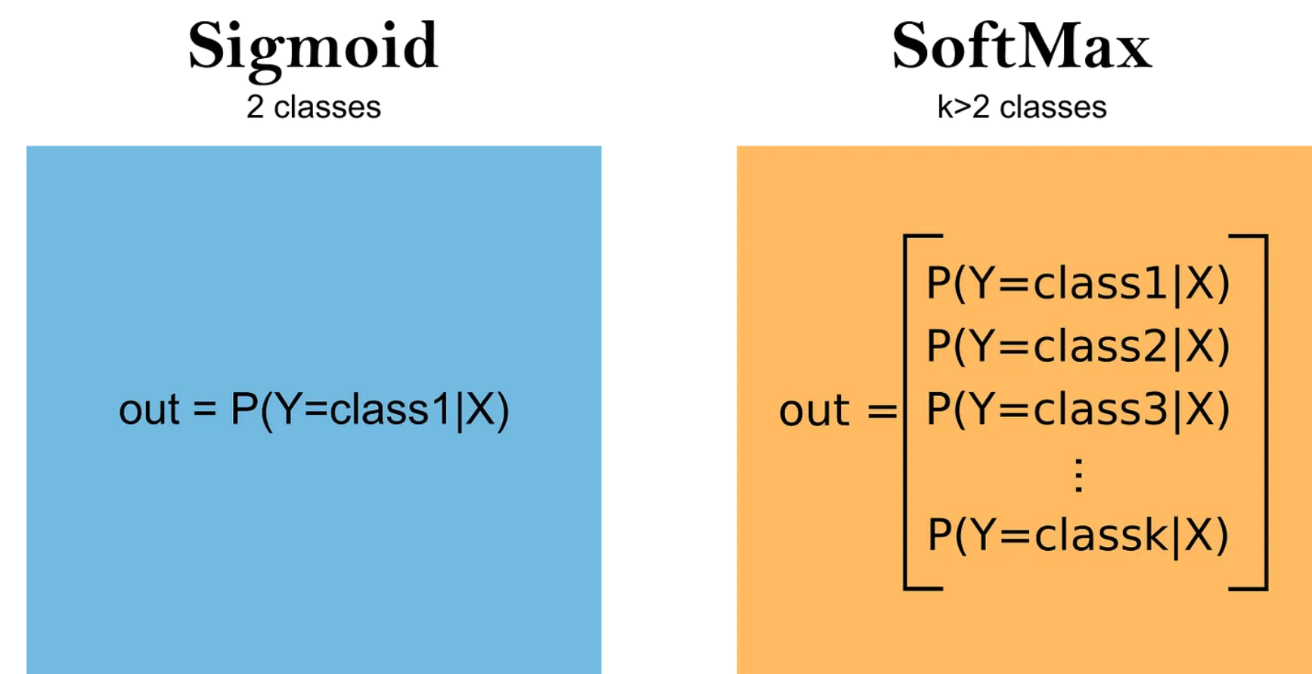
Sigmoid vs SoftMax
But if both functions map the same transformation. Difference between them?
Sigmoid is used for binary classification methods where we only have 2 classes,
while SoftMax applies to multiclass problems. In fact, the SoftMax function is an extension of the Sigmoid function.

Slide 30
